Slide 1
第16章
多目标规划和
目标规划

Slide 2
目录 CONTENTS
01
多目标规划
02
目标规划

Slide 3
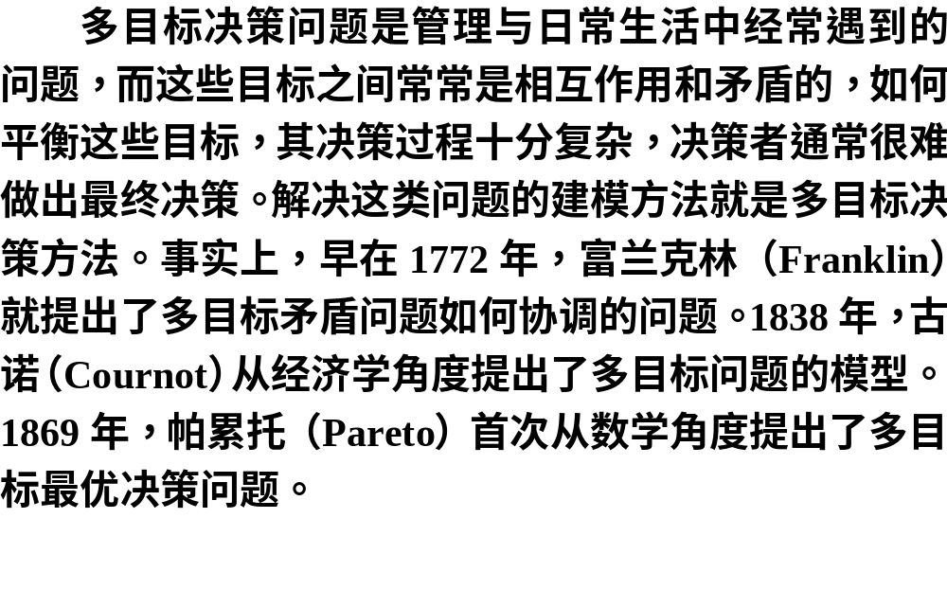

Slide 4


Slide 5
多目标规划
01

Slide 6
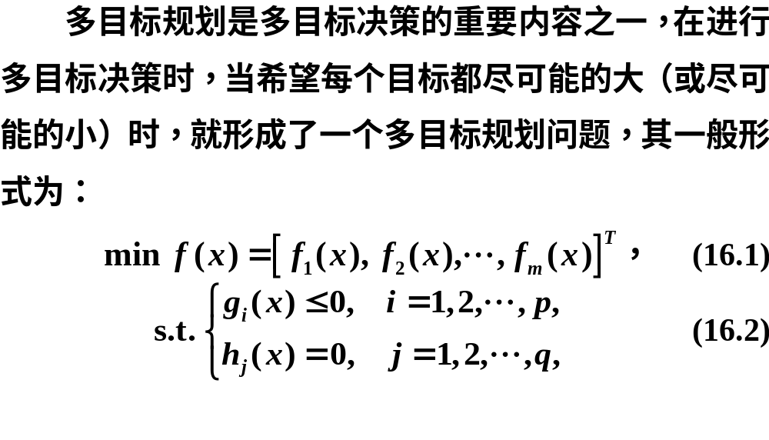
16.1.1多目标规划问题的基本理论

Slide 7
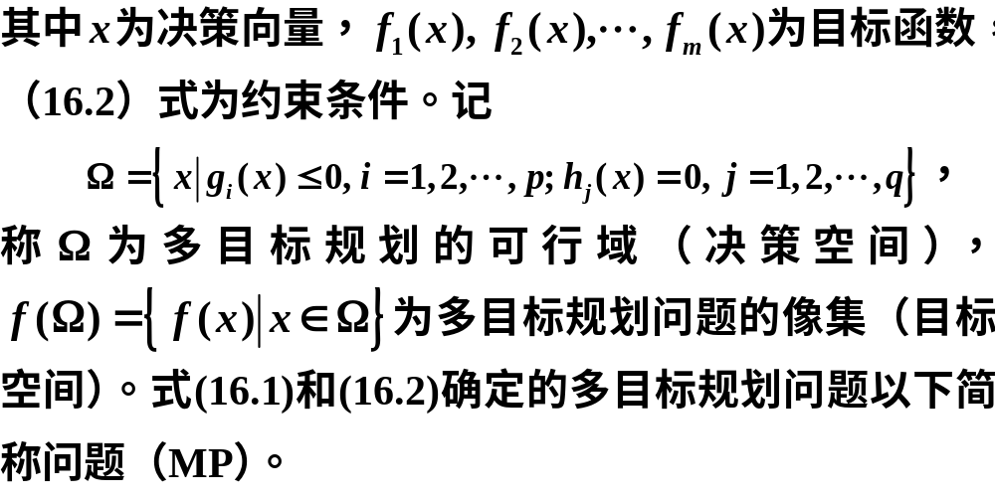

Slide 8
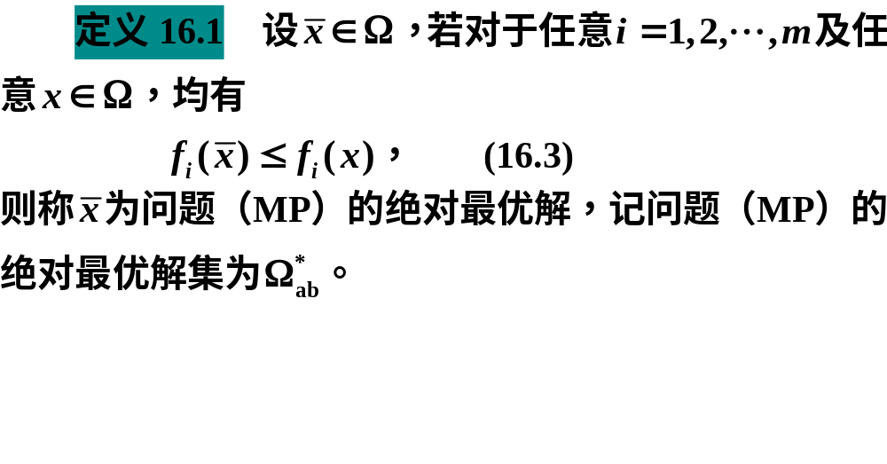

Slide 9
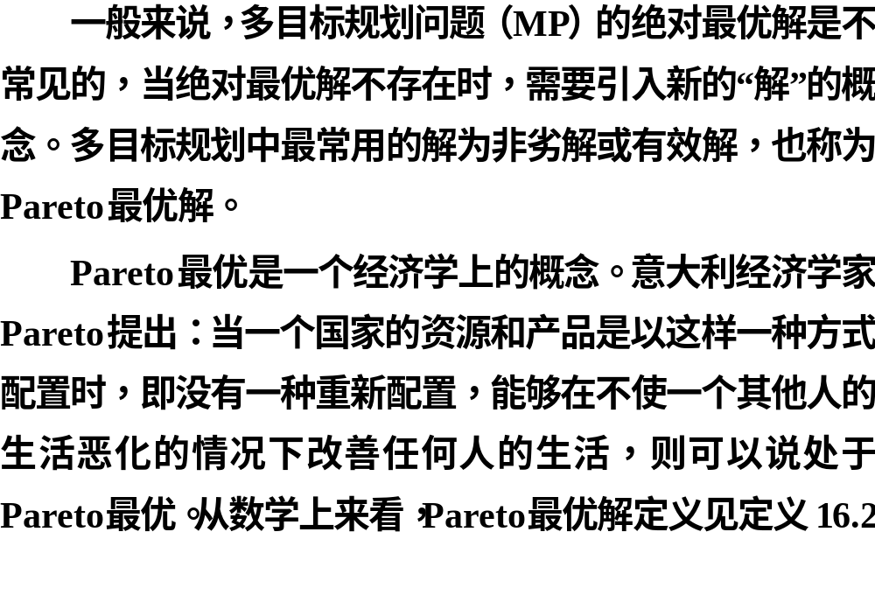

Slide 10
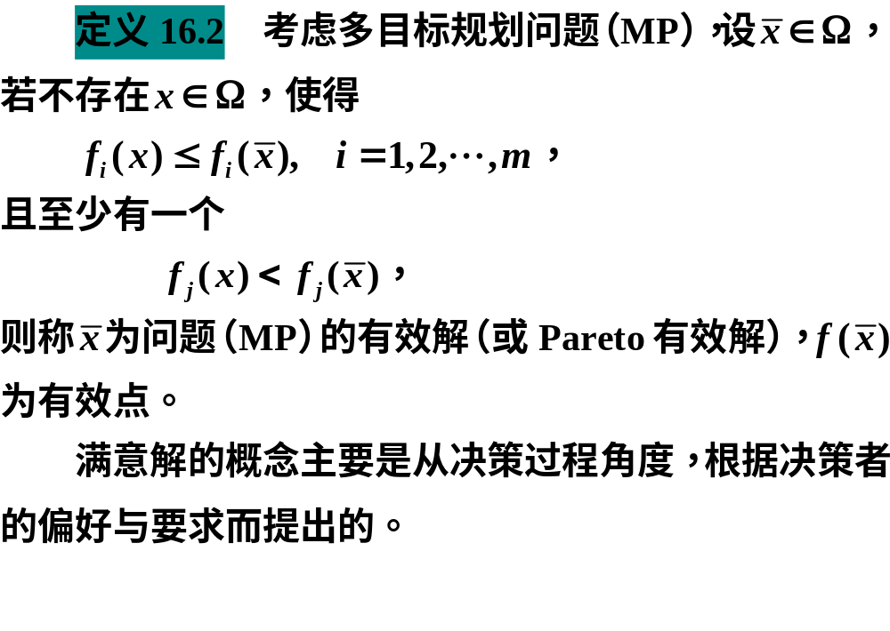

Slide 11
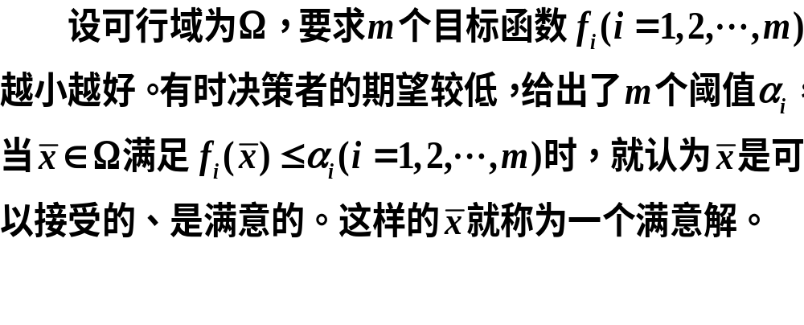

Slide 12


Slide 13
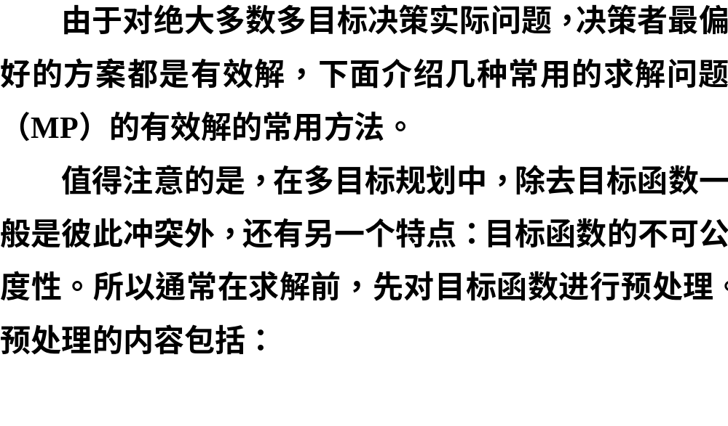
16.1.2求有效解的几种常用方法

Slide 14


Slide 15


Slide 16

1.线性加权法

Slide 17
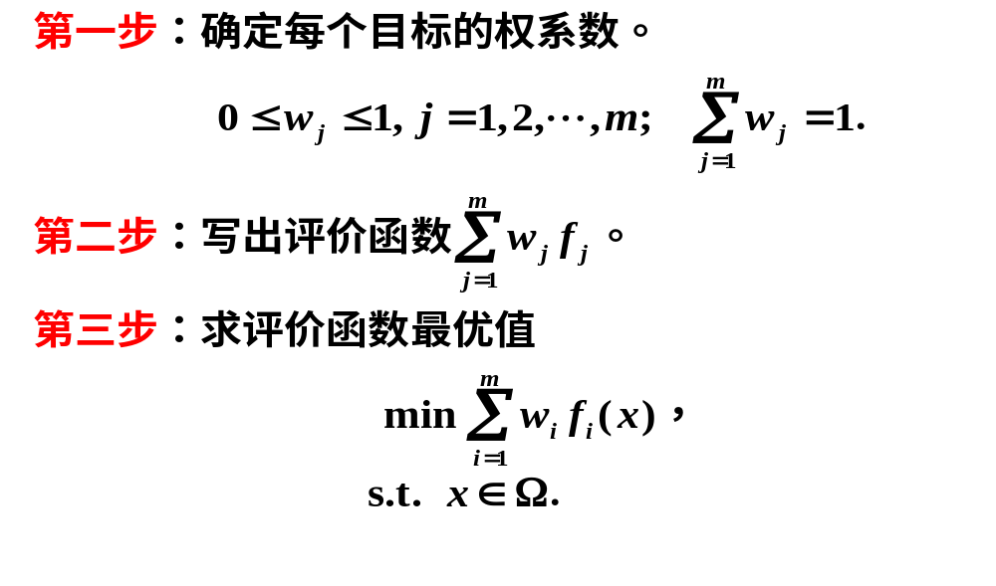

Slide 18
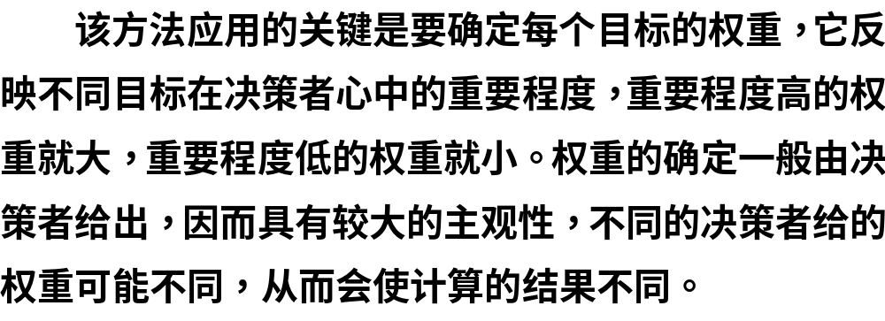

Slide 19
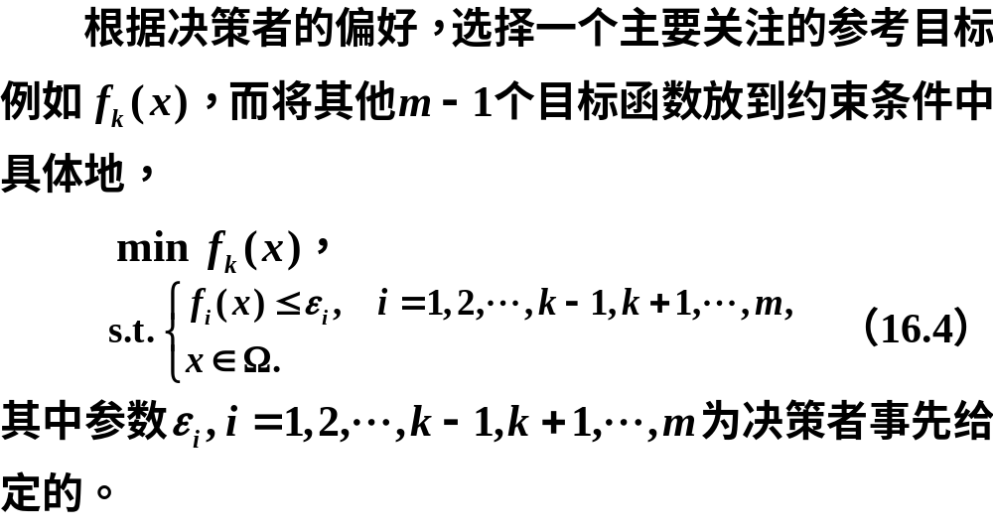
2.ε约束法

Slide 20
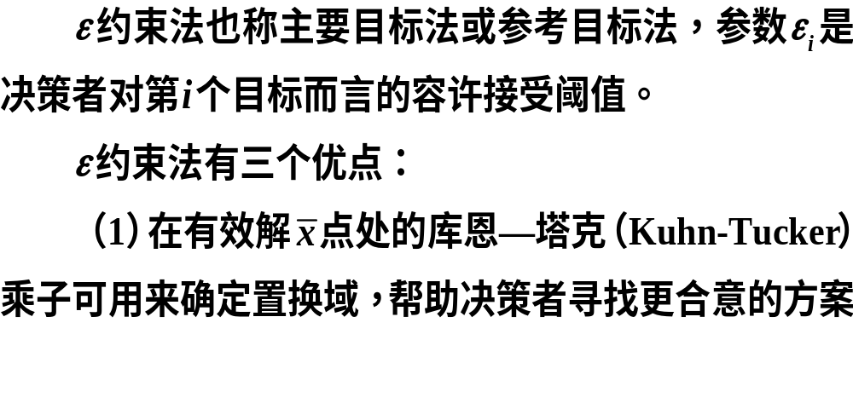

Slide 21

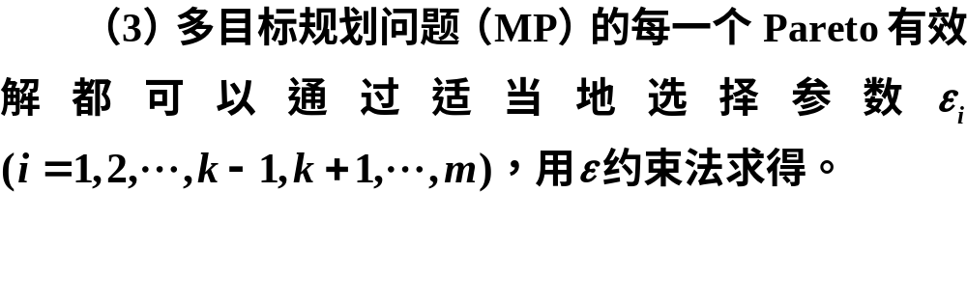

Slide 22
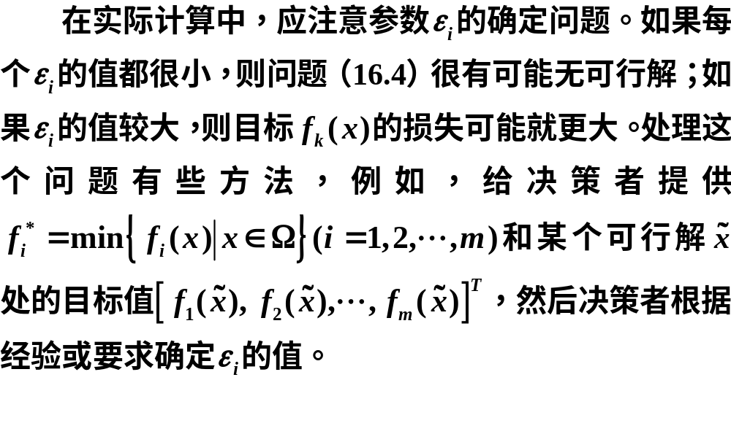

Slide 23

3.理想点法

Slide 24
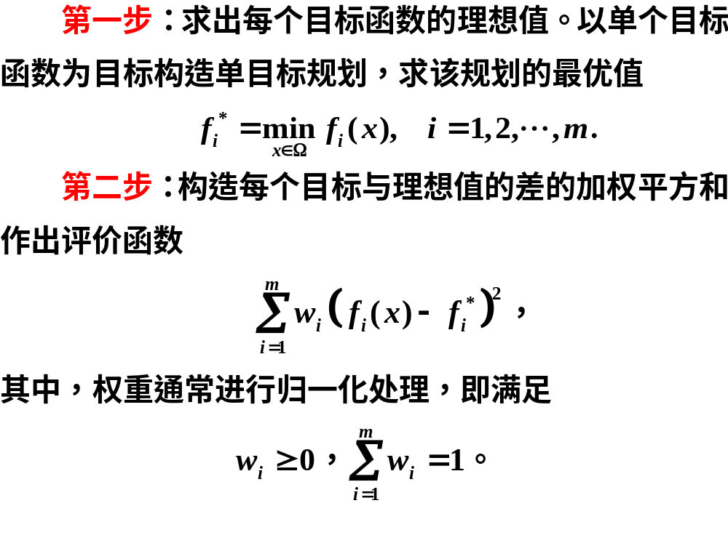

Slide 25
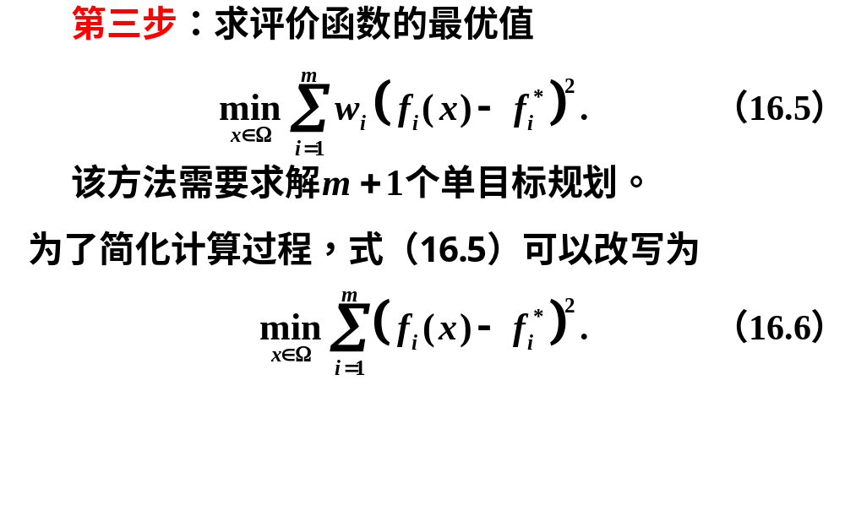

Slide 26

4.优先级法

Slide 27
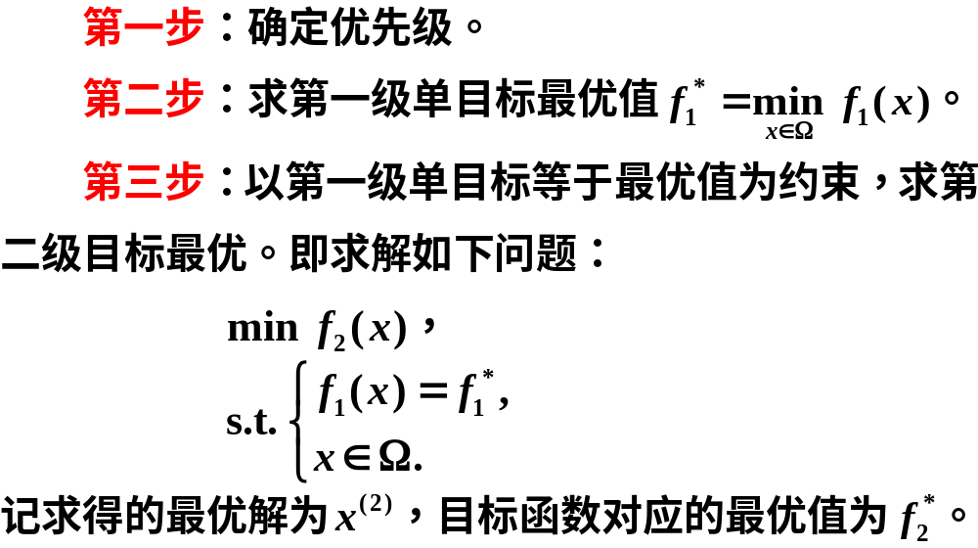

Slide 28
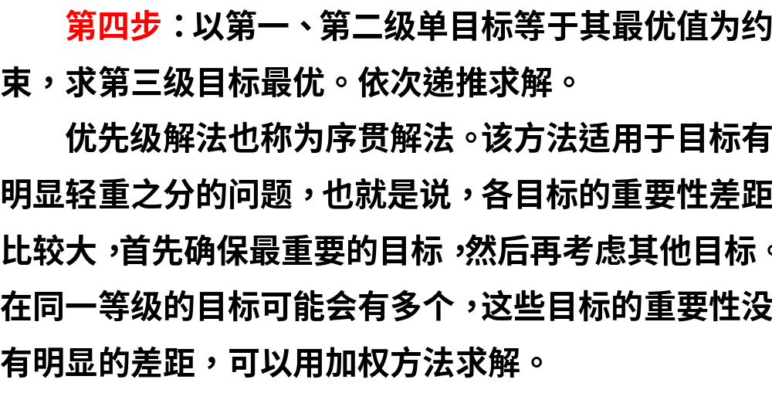

Slide 29
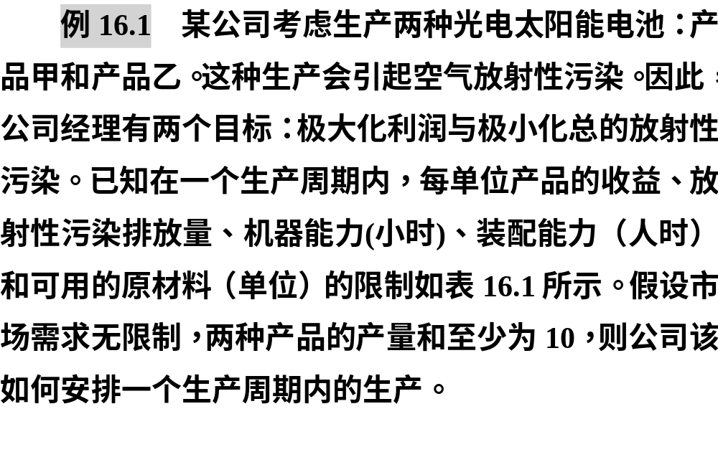

Slide 30
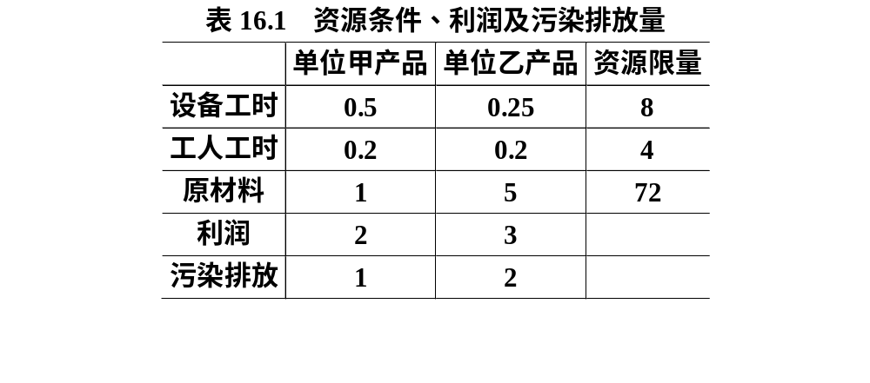

Slide 31
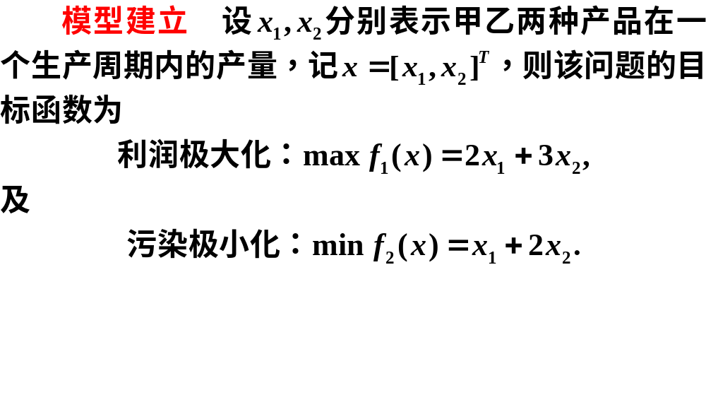

Slide 32
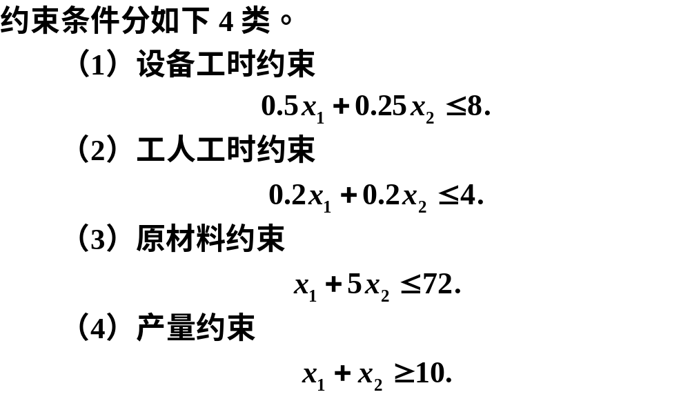

Slide 33
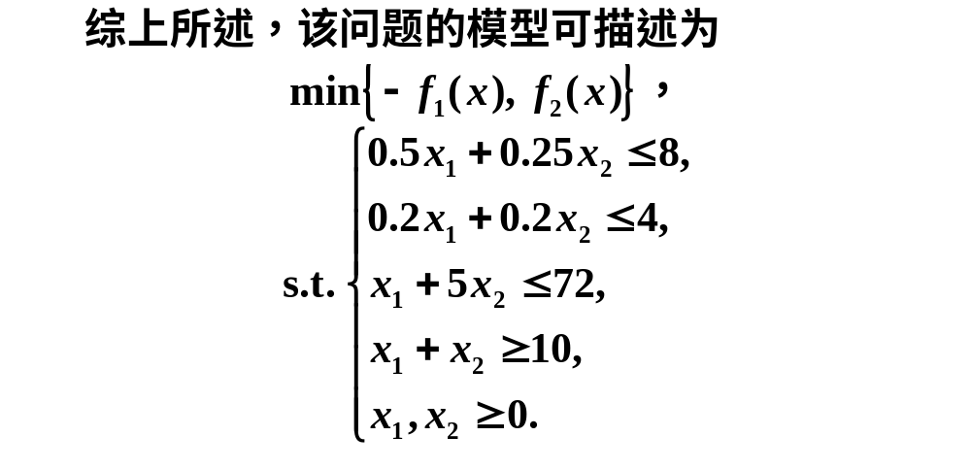

Slide 34
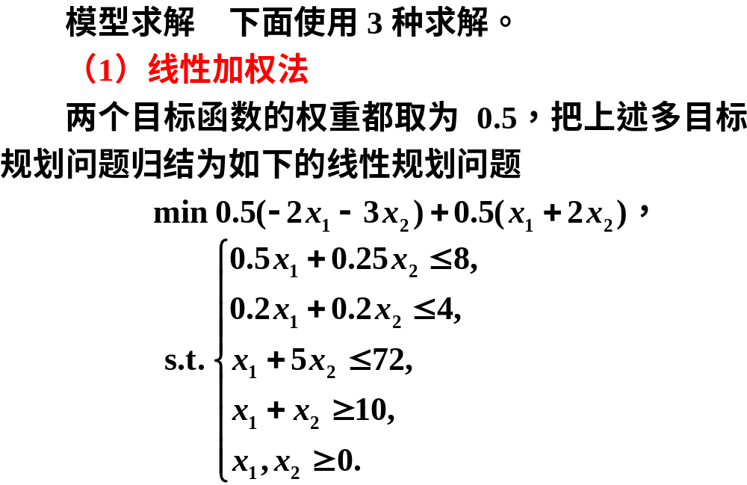

Slide 35
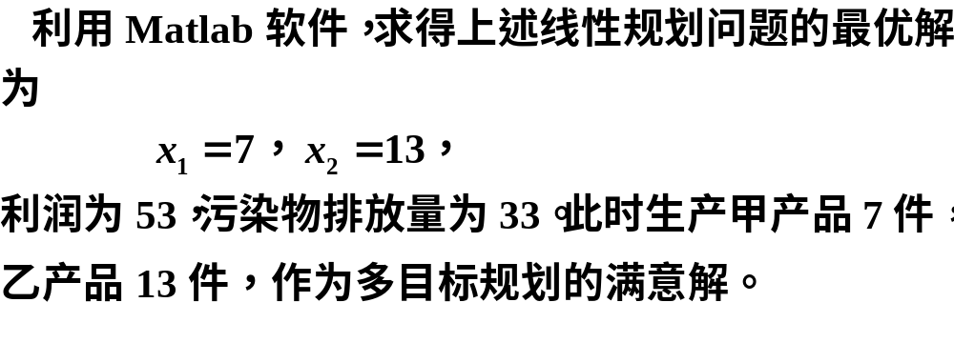

Slide 36
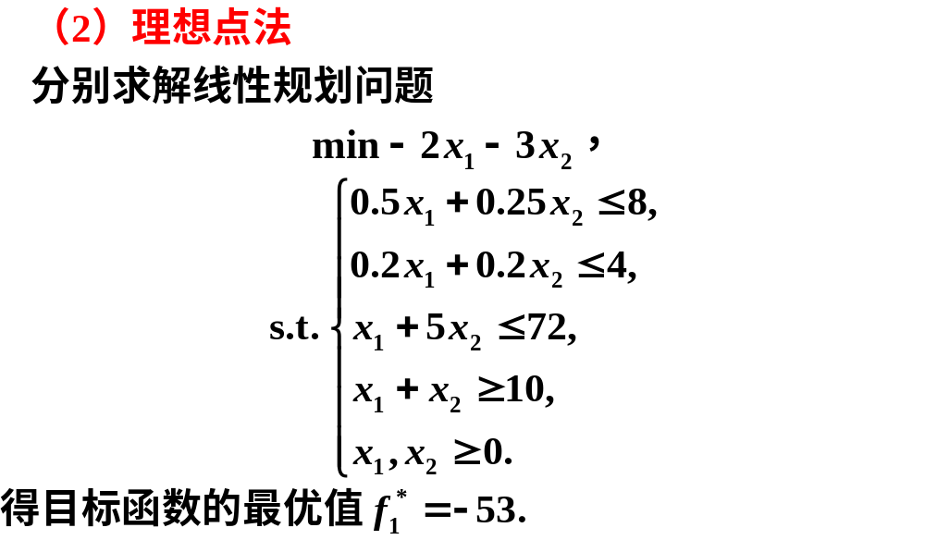

Slide 37
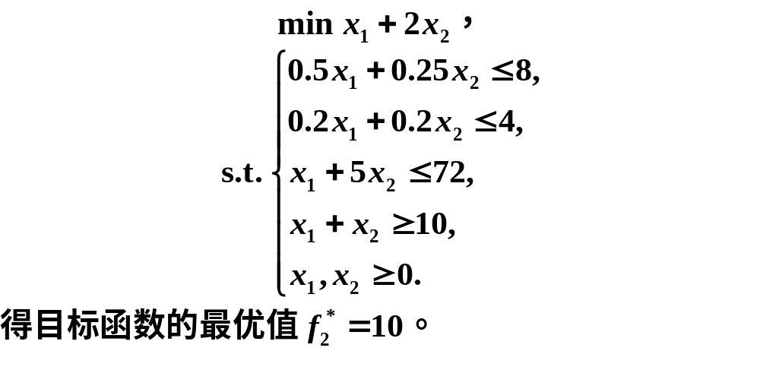

Slide 38
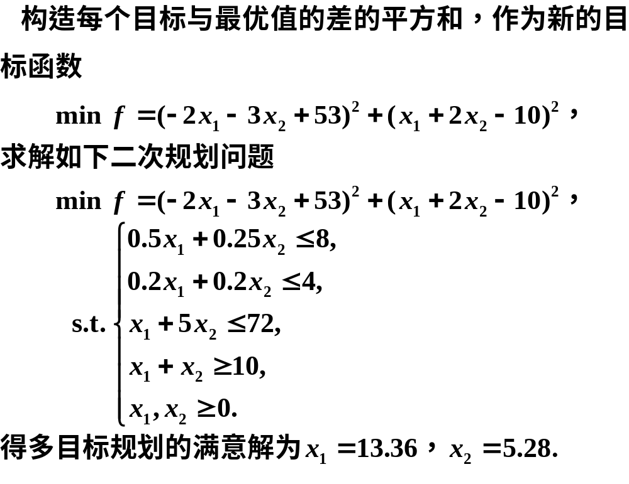

Slide 39
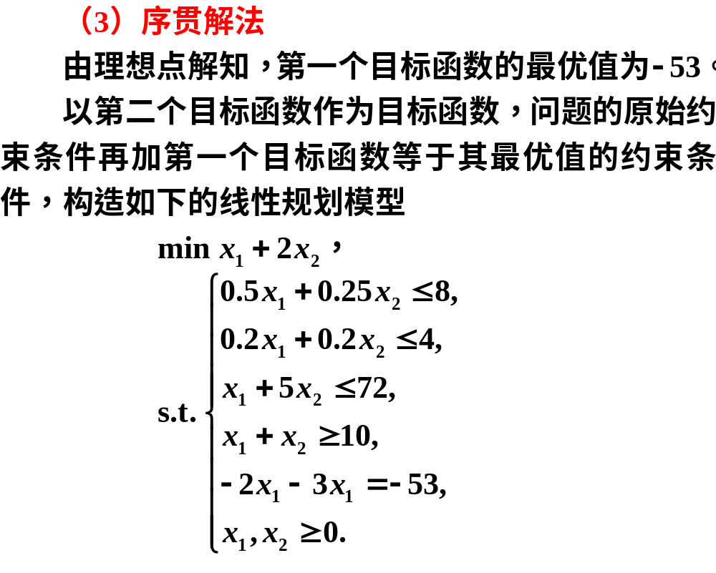

Slide 40


Slide 41
clc, clear, prob=optimproblem;
x=optimvar('x',2,'LowerBound',0);
c1=[-2, -3]; c2=[1, 2];
a=[0.5, 0.25; 0.2, 0.2; 1, 5; -1, -1];
b=[8; 4; 72; -10];
prob.Constraints.con1 = a*x<=b
obj1=0.5*c1*x+0.5*c2*x
prob1 = prob; prob1.Objective=obj1;
[sol1, fval1]=solve(prob1), sx=sol1.x
f1=-c1*sx, f2=c2*sx

Slide 42
prob21=prob; prob21.Objective=c1*x;
[sol21,fval21]=solve(prob21), sx21=sol21.x
prob22=prob; prob22.Objective=c2*x;
[sol22,fval22]=solve(prob22), sx22=sol22.x
prob23=prob;
prob23.Objective=(c1*x-fval21)^2+(c2*x-fval22)^2;
[sol23,fval23]=solve(prob23), sx23=sol23.x

Slide 43
prob3=prob; prob3.Objective=c2*x;
prob3.Constraints.con2=c1*x==fval21;
[sol3,fval3]=solve(prob3), sx3=sol3.x

Slide 44
目标规划
02

Slide 45
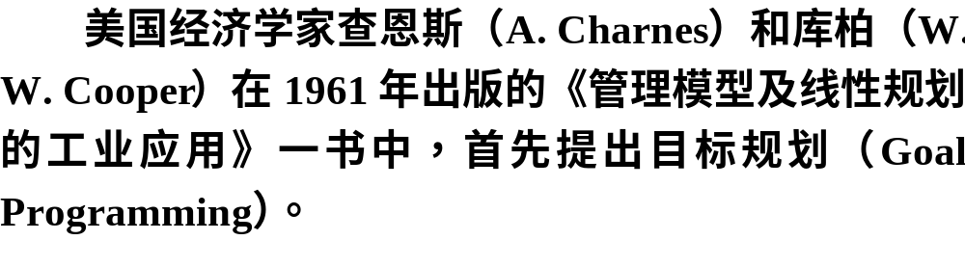

Slide 46

16.2.1 目标规划的数学模型
1.目标规划的概念

Slide 47
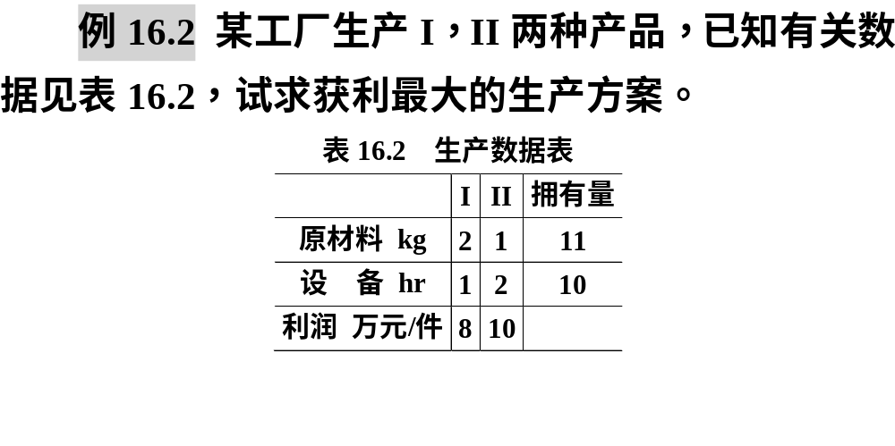

Slide 48
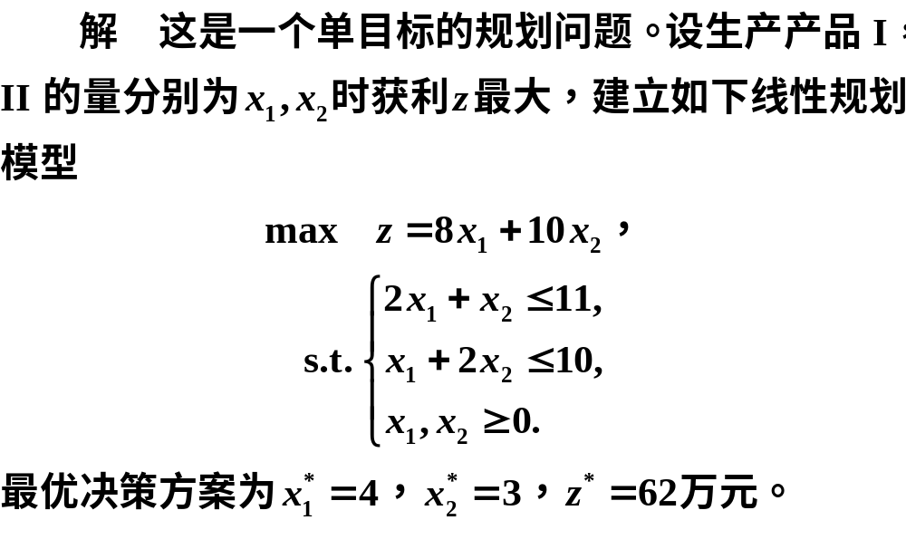

Slide 49
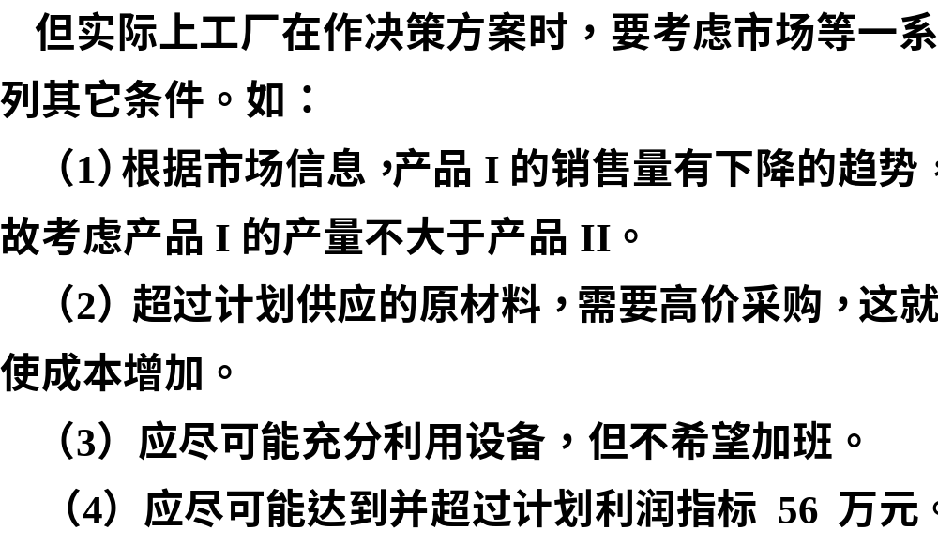

Slide 50


Slide 51
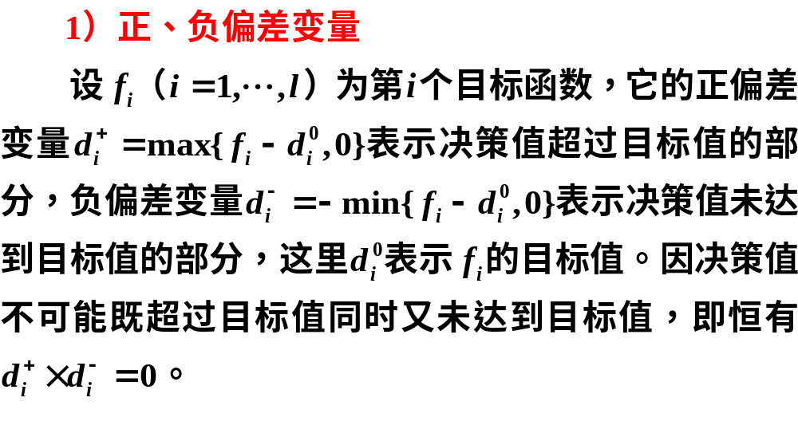

Slide 52
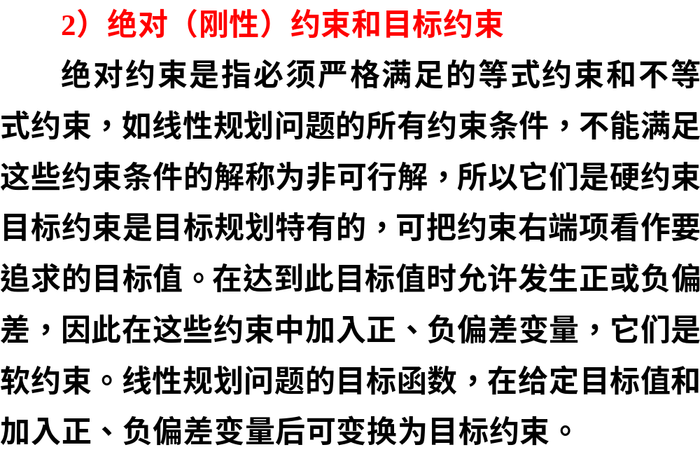

Slide 53


Slide 54
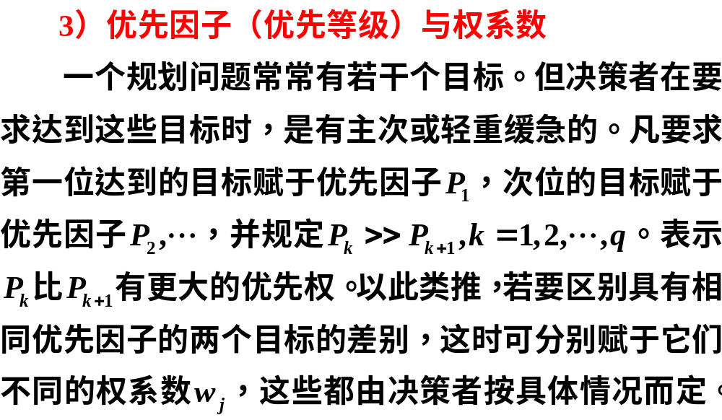

Slide 55
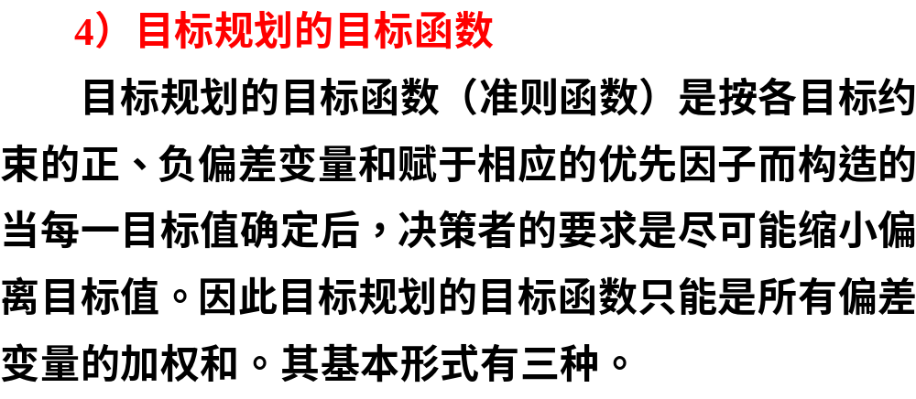

Slide 56



Slide 57
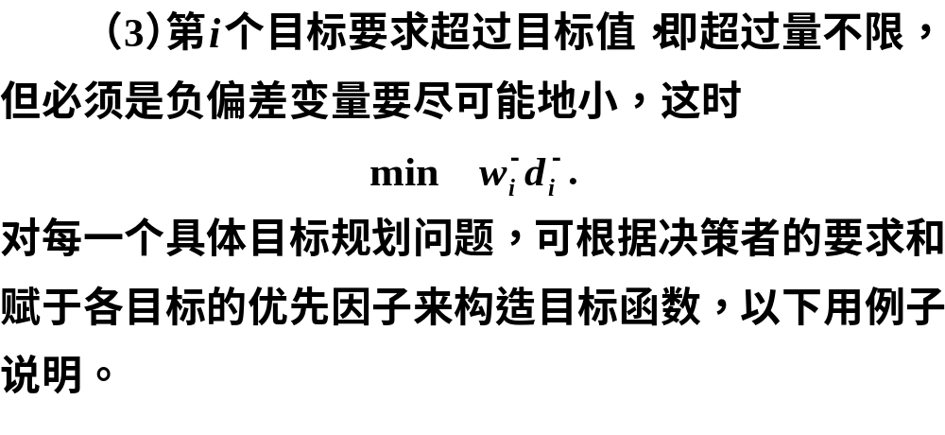

Slide 58
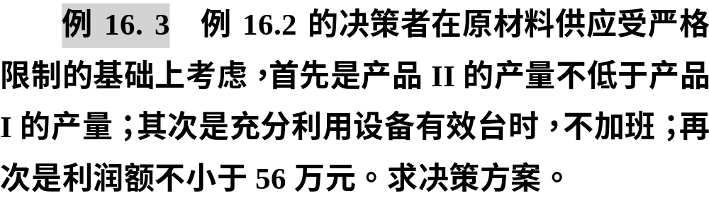

Slide 59
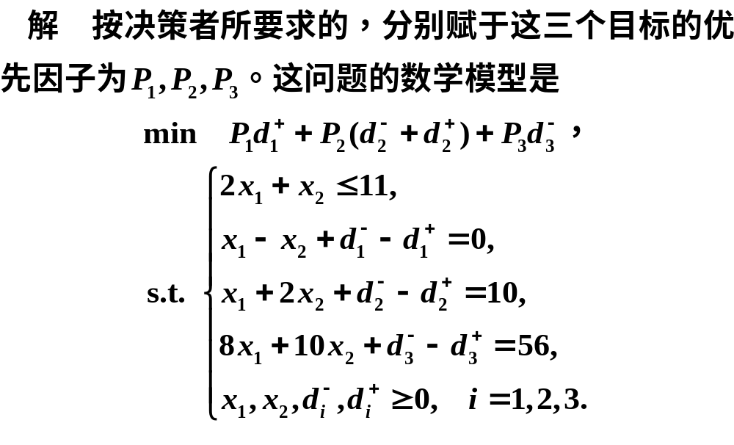

Slide 60
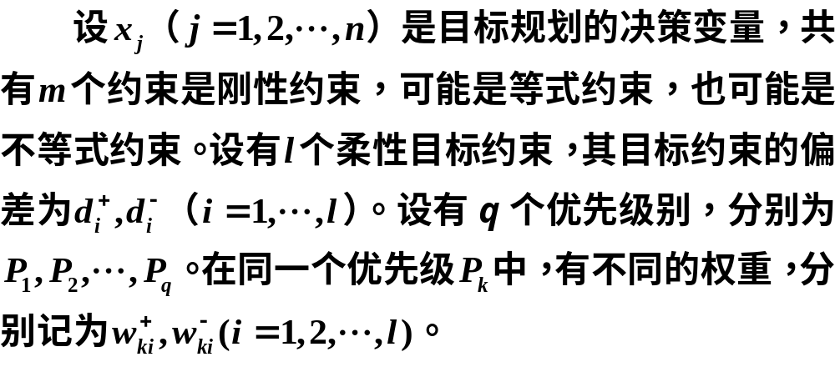
2.目标规划的一般数学模型

Slide 61
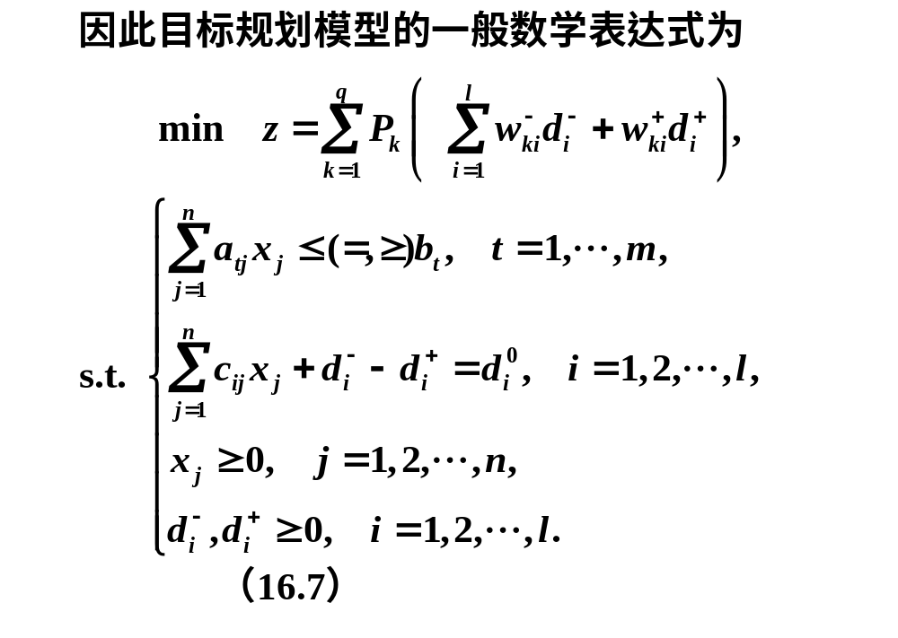

Slide 62


Slide 63

16.2.2 求解目标规划的序贯算法

Slide 64
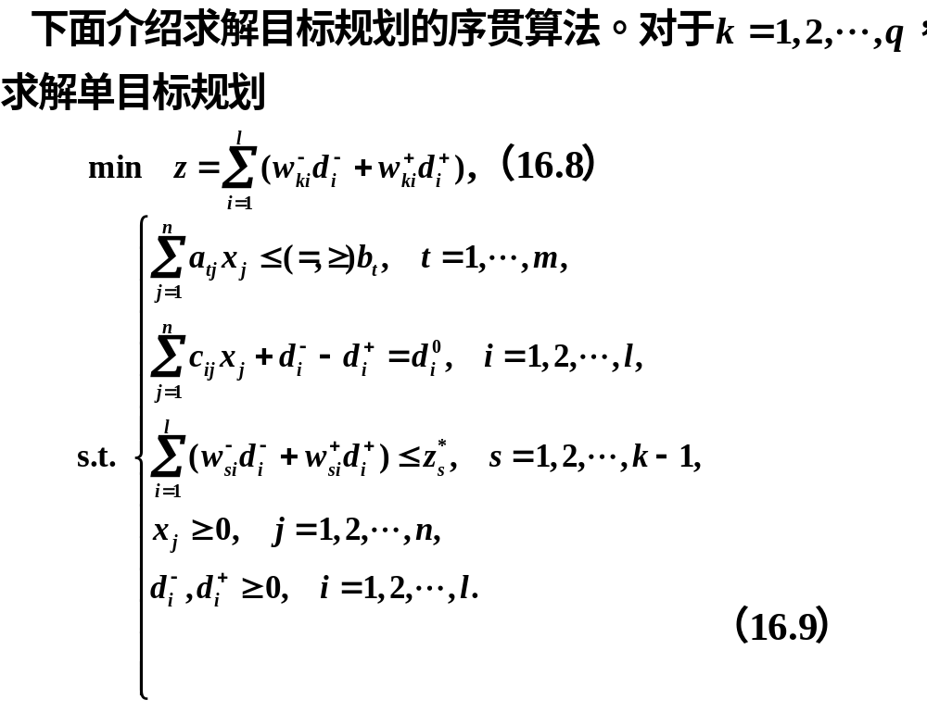

Slide 65
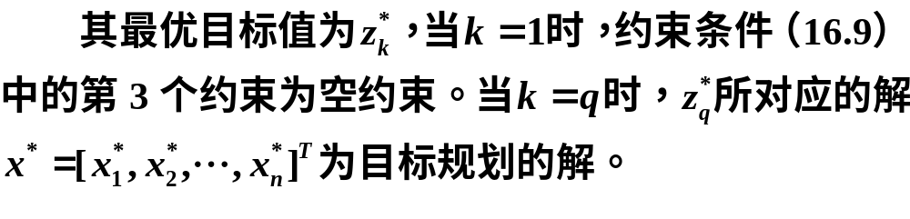


Slide 66
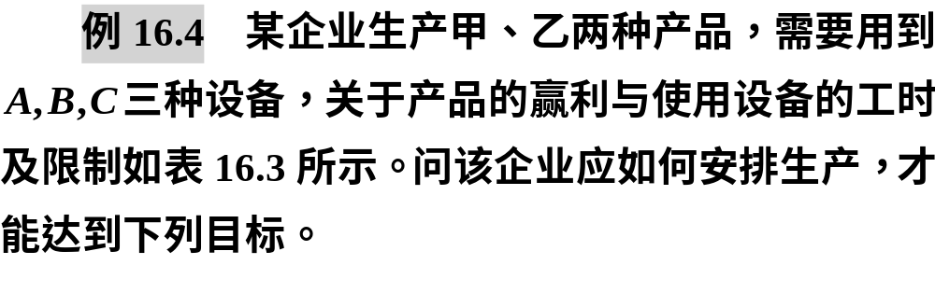

Slide 67
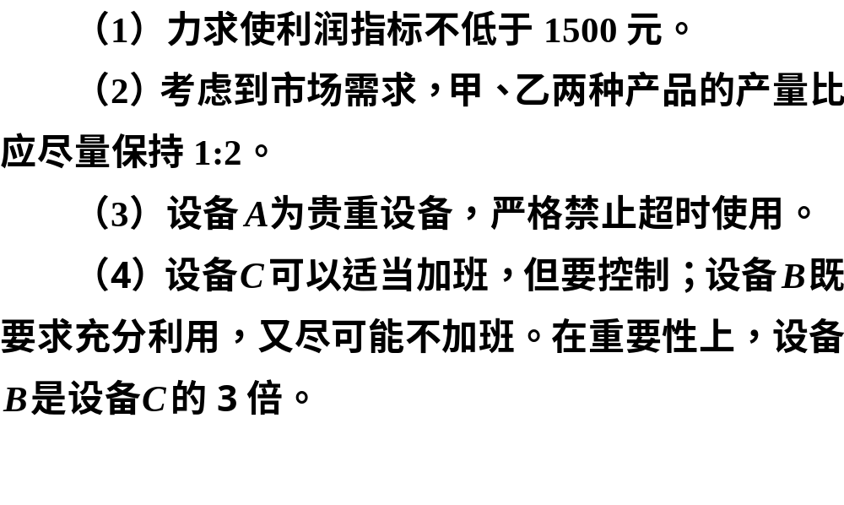

Slide 68
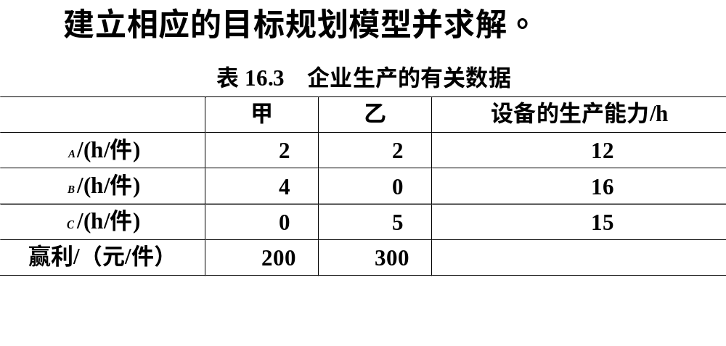

Slide 69
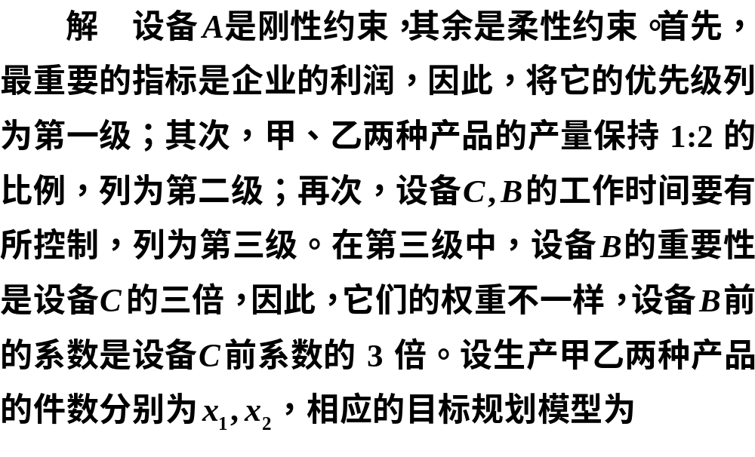

Slide 70
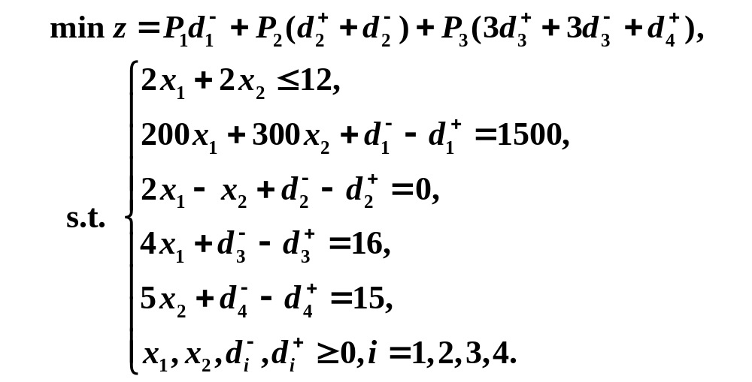

Slide 71


Slide 72
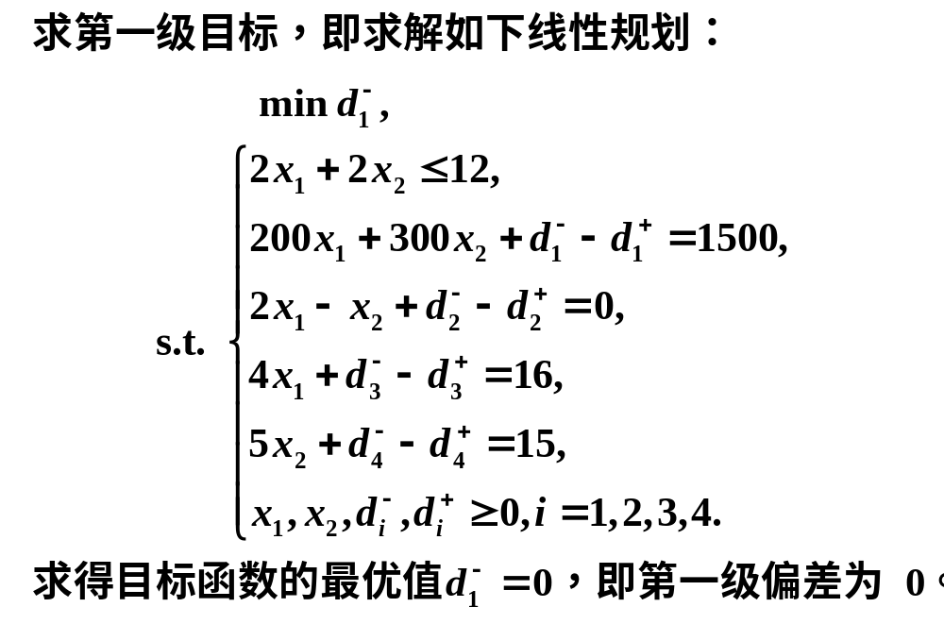

Slide 73


Slide 74


Slide 75


Slide 76
clc, clear
x=optimvar('x',2,'LowerBound',0);
dp=optimvar('dp',4,'LowerBound',0);
dm=optimvar('dm',4,'LowerBound',0);
p=optimproblem('ObjectiveSense','min');
p.Constraints.con1 = 2*sum(x)<=12;
con2=[200*x(1)+300*x(2)+dm(1)-dp(1)==1500
2*x(1)-x(2)+dm(2)-dp(2)==0
4*x(1)+dm(3)-dp(3)==16
5*x(2)+dm(4)-dp(4)==15];
p.Constraints.con2=con2;
goal=100000*ones(3,1);
mobj=[dm(1); dp(2)+dm(2); 3*dp(3)+3*dm(3)+dp(4)];
for i=1:3
p.Constraints.cons3=[mobj<=goal];
p.Objective=mobj(i);
[sx,fval]=solve(p);
fprintf('第%d级目标计算结果如下：\n',i)
fval, xx=sx.x, sdm=sx.dm, sdp=sx.dp
goal(i)=fval;
end

Slide 77


Slide 78


Slide 79


Slide 80


Slide 81


Slide 82


Slide 83


Slide 84


Slide 85


Slide 86
计算的Matlab程序如下：
clc, clear
x=optimvar('x',3,'LowerBound',0);
dp=optimvar('dp',8,'LowerBound',0);
dm=optimvar('dm',8,'LowerBound',0);
p=optimproblem; %默认目标函数最小化
b=[50,50,80,100,120,100]';
con1=[5*x(1)+8*x(2)+12*x(3)+dm(1)-dp(1)==1700
x(1:3)+dm(2:4)-dp(2:4)==b(1:3)
x(1:3)+dm(5:7)-dp(5:7)==b(4:6)
5*x(1)+8*x(2)+12*x(3)+dm(8)-dp(8)==1900];
p.Constraints.con1=con1;
goal=100000*ones(5,1);
mobj=[dm(1); 20*dm(2)+18*dm(3)+21*dm(4); dp(8)

Slide 87
20*dm(5)+18*dm(6)+21*dm(7); dp(1)];
for i=1:5
p.Constraints.cons2=[mobj<=goal];
p.Objective=mobj(i);
[sx,fval]=solve(p);
fprintf('第%d级目标计算结果如下：\n',i)
fval, xx=sx.x, sdm=sx.dm, sdp=sx.dp
goal(i)=fval;
end
c = [1000,1440,2520]*xx %计算总利润

